Slide 1

Our Lady and St Patrick’s College, Knock
Applying to University
2025-26

Slide 2





Welcome

Slide 3

Kirkland Rowell Survey 2023
48% of our parents think their child will definitely attend university.
42% of our parents think their child will probably attend university.
NB It is the hours of study that get the grades to win the university offers/places.

Slide 4


Year 14 Leavers 2024
83- Queen’s University
26 - Ulster University
5 - Republic of Ireland
36 - England
12- Scotland
4 - Wales
4 - Teaching Colleges
7 - FE Institutions
16 - Gap Year
1 - Football

Slide 5

OLSPCK - We provide:
Careers Advice and Guidance
Weekly Careers class
Work Experience Weeks
Help with the application process
Liaison with universities and clearing
Time out of class for visits
One-to-one consultations
References
Post-exam support

Slide 6

Partnership with Parents
Parents have a central role to play
Discuss courses, options, finance, etc.
Use own knowledge and contacts
Help with research
Organise visits
Encourage and support
Ask about academic progress
Consult teachers

Slide 7

Areas of Focus
Careers Advice to date
Higher Apprenticeships
UCAS application process
Choosing a university or course
Personal Statements
Other application processes
Student Finance
Q and A

Slide 8

Careers Advice to date
University Talks
Open Days
UCAS Exhibition
Work Shadowing
Careers Lessons
Mock Interviews

Slide 9
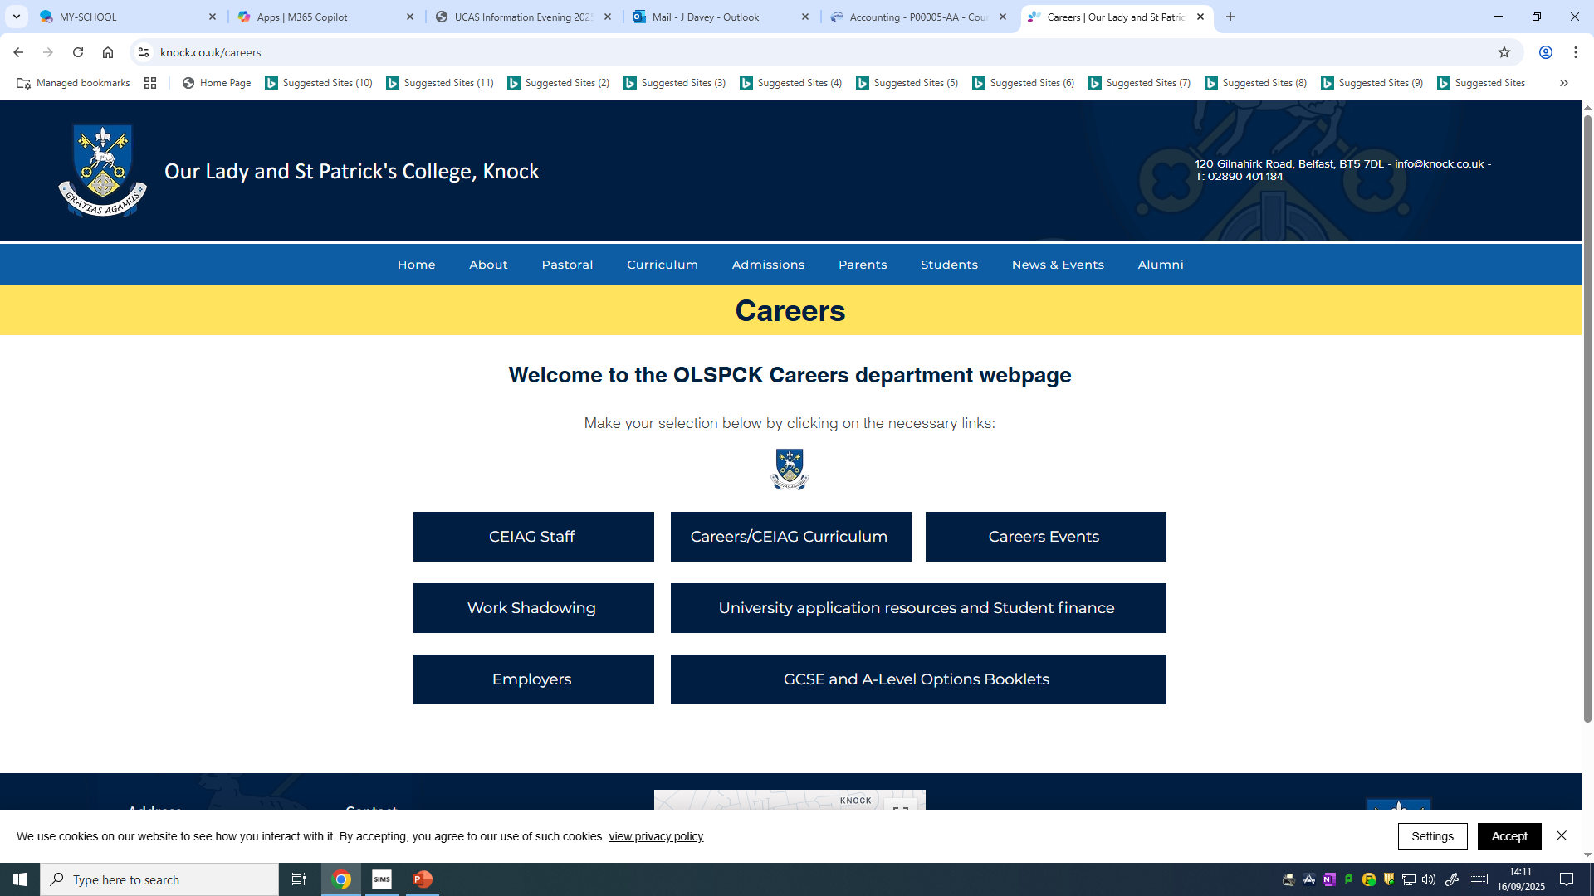
Work Shadowing

Slide 10



University Fees
University Fees:
NI Universities : £4,855
GB Universities: up to £9,535
Republic of Ireland Universities: €3,000
College of Further and Higher Education:
Belfast Metropolitan: £3110
Higher Apprenticeships: Free
Notes:
Will you be going into Higher Education in a N Ireland University, A GB university,a ROI university or indeed a Continental European university/
Will you study at a college of Further and Higher Education?
Or wil go go into the workplace and train up on a School Leaver’s Programme?

Slide 11
Higher Apprenticeship
More companies each year are introducing Higher apprenticeship course e.g. Deloitte, Kainos, PWC, Allstate, EY and Phoenix Law.
In summary the HLA scheme offers:
  Permanent job;
  Honours Degree OR equivalent qualification, completed on a part time over 4/5 years (free of charge);
  Starting salary of over £15,000+ per year, going up to over £20,000+ after 5 years;
  No student debt;
  4-5 years work experience.
The eligibility for applications is:
  5 GCSEs
  GCSE Maths: B or above
  GCSE English Language : C or above
  Projected 112 UCAS points (BBC) at A-Levels

Slide 12
Higher Apprenticeship
Ulster University
  https://www.ulster.ac.uk/apprenticeships/degree-apprenticeships
Deloitte
  https://www.deloitte.com/uk/en/careers.html
Allstate
  https://www.allstateni.com/careers/apprenticeships.aspx
Kainos
  https://www.kainos.com/careers/earn-as-you-learn
PWC
  https://www.pwc.co.uk/careers/early-careers.html
Engineering
  https://www.workplus.app/
EY
  https://ukcareers.ey.com/students/programmes/apprenticeships
ALMAC
  https://www.almacgroup.com/careers/higher-level-apprenticeships
Careers Service
  https://www.nidirect.gov.uk/articles/higher-level-apprenticeships

Slide 13
UCAS Application Process
All students should have registered with UCAS.
Various sections to be completed (early applicants 3rd October 2025, all other applicants 3rd November 2025):
  Personal Details;
  Education: including GCSE and AS results;
  Additional Educational Needs;
  Employment;
  Courses (up to 5 max, no preference order);
  Personal Statement;
  Students pay and send £28.95 (Free for students receiving FSM)
  Reference added.
Approved and sent by the school (early December).
Official UCAS deadline: 15th October 25/ 14th January 26.

Slide 14
UCAS Application Process
UCAS process the application form and forward it to chosen universities.
Students maybe invited to an interview or to complete an entrance exam.
Universities submit decisions.
Students view decisions on UCAS Hub.
Students reply to offers on UCAS Hub (Firm / Insurance). This date depends on when students receive all their decisions.
Universities confirm places when results are released in August.

Slide 15
Deferred Entry
Deferring means applying for a course then taking a year out before going to university.
Some universities do not allow deferred entry for some subjects.
Students still need to meet the conditions of any offers in the year that they apply.
On UCAS application form, students need to select the deferred entry start date when adding a choice on their UCAS application.

Slide 16

UCAS Application Process
All Decisions Made by Universities | Reply to Offers By
31st March | 6th May
13th May | 3rd June
Applicants may receive offers well before these dates and can reply before these deadlines.

Slide 17



University Decisions
Students will receive one of three decisions:
  Conditional Offer- depending on grades achieved
  Unconditional Offer- grades irrelevant
  Unsuccessful
Most students will receive conditional offers based on a combination of the following:
  AS and GCSE results;
  Your personal statement;
  Your reference and predicted grades;
  Interviews or admissions tests.

Slide 18
Conditional Offer
Grades (e.g. ABB with A in Maths)
UCAS Points
    ABB =128 points
    Levelling out? (BBB not the same as ABC)
Grade | A2 | AS
A* | 56 | NA
A | 48 | 20
B | 40 | 16
C | 32 | 12
D | 24 | 10
E | 16 | 6

Slide 19
Firm and Insurance Courses
When students have received decisions from ALL of their choices they will be asked to reply by a given date.
UCAS will send reminders – but if STUDENTS fail to reply by this date, their offers will be declined by UCAS automatically.
Students are able to hold 2 of their offers to the end of the cycle; all others must be declined.
Firm: Your first choice for where you want to go.
    Insurance : Your back-up choice but nevertheless it is a commitment like the firm course you have chosen. You will be placed here if you do not meet the conditions of your firm course.
    Changed your mind? 14 Days!

Slide 20
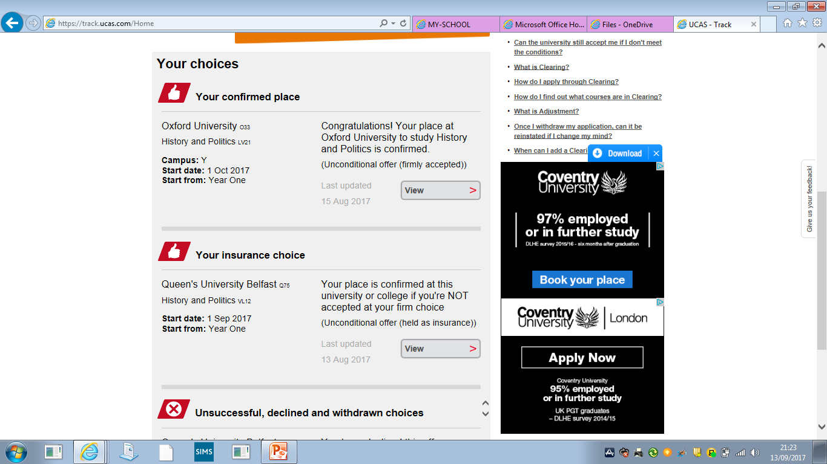

Track

Slide 21
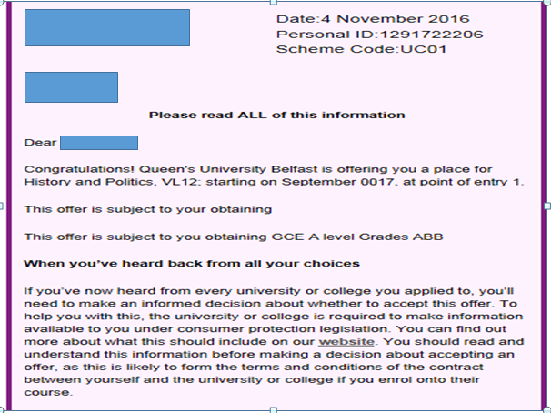

Slide 22
Unconditional Offers?
Increased number in recent years.
A number of students may receive an Unconditional Offer.
Advantages:
  Reduced exam stress
Disadvantages:
  Under-performance in exams;
  Choosing a university for the wrong reasons;
  Difficulties receiving an offer if you need to reapply.

Slide 23
UCAS Application Process: ‘Extra’
Open from 26th February to 1st July.
Allows additional single choices to be entered and considered one at a time.
Students eligible for Extra:
  Used all 5 choices;
  All choices unsuccessful, cancelled or offers declined.
Course vacancies listed on UCAS website.

Slide 24
UCAS Application Process: Clearing
Open from 2nd July to mid-September.
Allows additional single choices to be entered and considered one at a time.
Students must contact the university to discuss directly.
Students eligible for Clearing:
  Paid full fee (£28.95);
  All choices unsuccessful, cancelled or offers declined.
Course vacancies listed on UCAS website.

Slide 25
Choosing University or Courses
Research is vital!
Use the tools that are available to you:
UCAS website;
University prospectus / website;
Statistics: e.g Discover Uni, The Complete University Guide and Times Good University Guide;
Open Days.
5 Courses?

Slide 26
Choosing University or Courses
You should consider:
Your interests;
Your academic strengths;
What you enjoy studying;
Course content;
Your desired career path;
Entry requirements;
Location;
Fees;
Facilities
Support Offered.

Slide 27
Personal Statement
Why do you want to study this course or subject?​
How have your qualifications and studies helped you to prepare for this course or subject?​
What else have you done to prepare outside of education, and why are these experiences useful?

Slide 28
Personal Statement
Why do you want to study this course or subject?​
  Your motivations for studying this course.
  Your knowledge of this subject area and interests.
  Your future plans and why this is a good fit for you.

Slide 29
Personal Statement
​How have your qualifications and studies helped you to prepare for this course or subject?​
  How your studies or training relate to your chosen course or subject area.
  What relevant or transferable skills you have that make you a great candidate.
  Any relevant educational achievements

Slide 30
Personal Statement
What else have you done to prepare outside of education, and why are these experiences useful?
  Work experience, employment, or volunteering.
  Personal life experiences or responsibilities.
  Hobbies and any extracurricular or outreach activities.
  Achievements outside of school or college.
  Post-education activities.

Slide 31

Personal Statement

Slide 32
Personal Statement
Provides students the opportunity to sell themselves
It will be relatively short (4000 characters).
Each question must be answered.
It should be specific to the courses to which they are applying
Be concise and relevant (avoid superfluous detail)
It must be written in formal language (e.g. ‘I have’ NOT ‘I’ve’ or ‘Biology’ NOT ‘Bio’)
It must be the student’s own work (use of AI / Chat GPT).

Slide 33
Personal Statement:
Do’s and Don’ts
Do:
Make it interesting and personal to you;
Be positive;
Be specific;
Draft and redraft;
Get a second opinion;
Redraft again;
Double check grammar, spelling and punctuation;
Submit to your Careers teacher

Slide 34
Personal Statement:
Do’s and Don’ts
Don’t:
Repeat yourself (each answer to the 3 questions
Be negative;
Mention something you would not be prepared to discuss at an interview;
Add superfluous detail;
List skills and experiences;
Quotes? Humour?

Slide 35

Parent, Guardian and Carer Guide

Slide 36

Applying to ROI
Application process is called CAO.
Completed on line at www.cao.ie
Advantages:
  Can choose up to 10 courses;
  No Personal Statement;
  Results based;
  Lower tuition fees (€3000/ year).
Disadvantages:
  Higher entry requirements for some similar courses in the UK;
  Unfamiliar application process;
  Require modern language (includes Irish).

Slide 37
CAO Points
Grade | A-Levels 1st-3rd | 4th A-Level | AS
A* | 192 | 24 | NA
A | 165 | 24 | 24
B | 142 | 20 | 20
C | 120 | 18 | 18
D | 100 | 16 | 16
E | 67 | 14 | 14
Example:
Four As at A levels 495 + 24 = 519.
Three As at A level: 495.
25 additional points will be awarded for a grade E or better in Mathematics at A2 level.

Slide 38
CAO Entry Requirements
There are no entry requirements published for 2026.
You can only view points range for the previous year e.g. UCD 2025:
  Law: 556-625 points (A*A*A A/a )
  History and Politics: 467 points (ABBb)
All courses have basic entry requirement referred to as ‘Matriculation’.
For example, Grade C or better in two subjects at A-level and passes in 4 other subjects at A-level/GCSE.

Slide 39
Applying to ROI
Students must inform CAO if they are taking their Summer 2026 examinations with CCEA or with British examination boards.
You must inform CAO of any GCSE examinations previously taken.
You must provide certified copies of certificates/statements of results produced by an examining board to CAO.
Failure to provide this information on time can result in you losing your place.

Slide 40
Choosing your courses
PLACE YOUR COURSE CHOICES IN GENUINE ORDER OF PREFERENCE!
IT IS A MISTAKE to base your choices only on your present expectations of examination performance or the points level of previous years.
If you are not successful in your first choice, this will have no effect on your chances of obtaining a place in one of your lower preferences.
Having received an offer in any round, you may get a higher preference offer in a later round. YOU WILL NEVER BE OFFERED A LOWER PREFERENCE IN A LATER ROUND.

Slide 41
Receiving an offer
If the student meets the minimum entry requirements for the course, the student’s points are calculated.
All eligible students are then placed on a list, in order of academic merit, for each course that they applied for.
CAO then makes offers to the required number of applicants on each course starting with the applicant with the highest points and working down until enough places have been offered.

Slide 42
CAO Key Dates (2025/26)
5th November | CAO online application facility opens.
1st February | Normal closing date for applications.
6th May | Online Change of Mind facility becomes available
Before End of May | Statement of Application Record sent to all applicants
1st July | Change of Mind closes
27th August | Round 1 Offers
8th September | Round 2 Offers

Slide 43

St Mary’s University College
Application to St Mary’s University is not made through UCAS.
It must be made directly to the College.
Application process opens 1st October and closes mid January.
Personal Statement.
Interviews for BEd courses are mid-February.
Entry requirements available at: www.smucb.ac.uk

Slide 44

Belfast Met
Numerous courses available such as HNDs or Foundation Degrees in a variety of areas.
Significantly lower entry requirements.
May provide an alternative route to university.
Provides a ‘Plan B’ if you don’t meet entry requirements for your Firm or Insurance offers.
Many courses have a direct link to QUB and UU.
Apply directly to Belfast Met
More information available at www.belfastmet.ac.uk

Slide 45
Student Finance (2025)
Student Finance opens March 2026, complete application by 30th April.
All students are eligible (few exceptions e.g. those applying to Nursing) providing they will be studying in the UK or ROI.
Tuition Fee LOANS are paid directly to the university.
Maintenance LOANS are means tested. Student can receive up to £6300 if living with parents and up to £8132 if living away from parent.
Maintenance GRANTS are not repayable but are only available to students based on household income.
  Full grant, income <£19203
  Partial grant, income <£41065.

Slide 46
Student Finance
If you leave your course before the of:
  Term 1 you must pay 25% of the fee;
  Term 2 50%;
  Term 3 100%.
Bursaries are available from each university and other sources such as JP McManus All Ireland Scholarship.
More information available from www.studentfinanceni.co.uk

Slide 47
When will you start to make repayments?
Once you earn over £26,065 a year, you will repay 9% of anything over this amount.
For example, if you are paid monthly and earn £2,500 before tax per month you would repay 9% of the difference between what you earn and what the threshold is:
  £2,500 - £2172 = £328
  9% of £328 = £30
  So your student loan repayment would be £30 a month.
If your income is below £26,065 or drops to below that amount, you will not have to make repayments.
It will be cancelled 25 years after you became eligible to repay.

Slide 48
Repayment Plan
Income Before Tax | Monthly Salary | Monthly Repayments
£26065 | £2172 | £0
£28000 | £2333 | £15
£30000 | £2500 | £30
£35000 | £2917 | £67
£40000 | £3333 | £105

Slide 49
Results Day (13/8/26)
Confirm acceptance of Firm or Insurance Offer.
If students have not been successful in meeting the offer requirements, students may have to await a decision or universities may offer alternative courses.
Have all useful contacts and Information at hand e.g. UCAS ID, Universities, Belfast Met etc.
Enter Clearing:
  Issued a clearing number;
  Look at courses available;
  Make contact with universities;
  Add course on Track.
Careers Advice provided by school.

Slide 50
Useful Contacts
QUB
  028 9024 5133
UU
  028 9036 8760
Student Finance NI
  www.studentfinanceni.co.uk
  0300 100 0077
UCAS
  0371 468 0 468
Belfast Met
  028 9026 5265

Slide 51
Questions?

