Slide 1
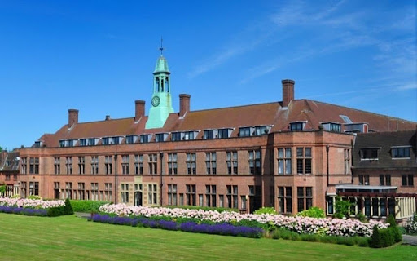
EYP Liverpool 2025
Liverpool Hope Creative Campus 28 – 31 August

Slide 2
Staff accompanying the trip
Ms Mezza (Trip Leader)
Ms McCluskey (Deputy Leader)

Slide 3

Accommodation
Liverpool Hope Creative Campus
Shaw Street L6 1HP
Students will be at Creative Campus for the duration of the visit and must not leave the site.
All meals included.
Students may wish to bring snacks.
They should bring a refillable water bottle.

Slide 4
Travel Information
Departure:
Belfast City Airport
Thursday 28/08/25
11:50 Depart Belfast
12:35 Arrive Liverpool. Taxi to Liverpool Hope Creative Campus. Cash needed for taxi fares to and from airport – £30 return.
Easyjet: EZY532
Meet inside main entrance of Belfast City George Best Airport 10:00

Slide 5
Return from Liverpool: Sunday 31/08/25
15.15 : Depart Liverpool
Flight: Easyjet EZY533
16:05: Arrive Belfast City Airport
Parents must collect from airport

Slide 6
Baggage Allowance
1 x under seat cabin bag max 45×36×20cm
1 large cabin bag max 56×45×25cm max 15 kilos
NB All liquids must be 100ml or less and kept in a clear resealable bag
No sharp objects e.g. nail file, tweezers, razors
Leave expensive items at home e.g. jewellery
Remember photographic ID – driver’s licence or passport

Slide 7
Code of Conduct
Excellent behaviour is expected.
Parents/guardians & the travelling students have already signed a code of conduct to ensure that the trip is safe & enjoyable for everyone. Please review before departure.
NO cigarettes, tobacco or nicotine, alcohol, solvents, illegal drugs in students’ possession at any time.
For the entire duration of the trip, students must cooperate with and respect other travellers, members of the public, teachers, fellow delegates and EYP organisers.
Students must not leave their rooms after lights out or enter accommodation of students of opposite sex.

Slide 8
Supervision
Students will be under the direct supervision of EYP leaders for daytime activities.
Students will be under the direct supervision of accompanying College staff each evening.
Students will report to Ms Mezza or Ms McCluskey if they encounter any issue or difficulty.
Emergency mobile no: 07824 150787

Slide 9
Emergency numbers
The school office: 02890 401184
Ms Mezza College Mobile: 07824 150787

